Slide 1
Medical Research
Mohammed Khalil AlMohri
Mrs. Timm
12D
10/3/2013

Slide 2
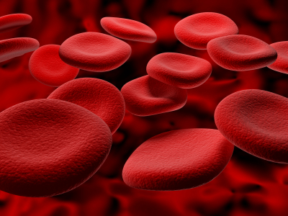
Introduction
Why should we know about blood circumstances ?
  Blood is an essential tool in our physiological system. If something is wrong with our blood, it may have a direct affect on our health. These are often called blood disorders.
  People may be affected with various blood disorders such as anemia, bleeding disorders ( e.g. hemophilia, blood clotting), and blood cancers (e.g. leukemia).
  One of the most severe cases of blood disorders are known as Sickle Cell Anemia, which is the case we are covering today.

Slide 3
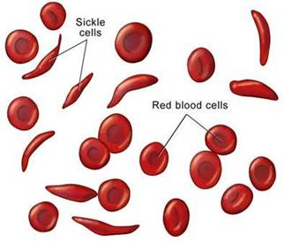
What is Sickle cell anemia ?
Inherited Blood Disorder
  Change in Hemoglobin
  Change in Shape of Normal red blood cells
  Blood Clusters
  Deoxygenated organs
Notes:
Sickle cell anemia is a blood disorder inherited from both parents with defective hemoglobin. Hemoglobin is responsible for the attraction of oxygen molecules to be transported through the blood stream. Normal red blood cells will carry oxygen from the lung throughout the body. Sickled-cells will not be able to transport oxygen through the body due to the cluster formation in capillaries. Organs will also not receive sufficient amount of oxygen leading to painful situations.("Sickle Cell Anemia" 140)

Slide 4

Sickle cell Inheritance
Inheritance
  Inherited from parents
  Ex; Blood type, eye color, height, skin color, etc…
  Hemoglobin are also inherited
Notes:
Sickle cell conditions are inherited from both parents just like the way eye color, hair color, height and other physical traits are inherited. Like most genes, hemoglobin genes is also inherited from parents. One gene from the mother and the other the father.

Slide 5
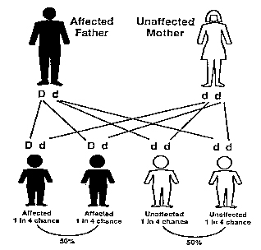
Sickle cell inheritance(continued)
Sickle cell inheritance
HBA ( Normal hemoglobin) and HBS ( Defective Hemoglobin)
Normal(HBA) vs. Affected(HBS)
Notes:
Sickle cell is inherited when HBA(normal hemoglobin) switches to HBS(defective hemoglobin). The person inheriting this can be affected or just be an unaffected carrier. If one parent is normal and the other has Sickle cell anemia, there a 50% chance that the kids will be affected. (1773; emphasis mine) (Fullwiley xvii)

Slide 6
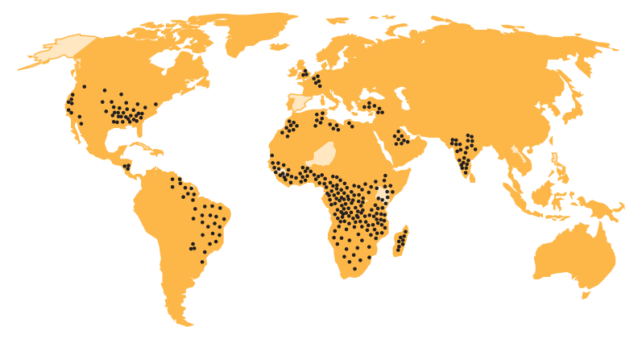
Who is at risk ?
Common in people from Africa, South/Central America, Mediterranean countries, and parts of the Middle Eastern region.
72,000 affected in USA where 2
million are carriers
1 in 500 blacks affected, 1 in 12 carrying the trait.
Notes:
It has been estimated that 72,000 people in the United Sates are affected by sickle cell, and as many as 2 million are carriers. The rates are relatively higher t among African-Americans with 1 in 500 Blacks affected and 1 in 12 carrying the trait.“ In contrast, an estimated population of 90 million, 45,000-90,000 babies are born with sickle cell disease. ("Sickle Cell Anemia" 140)

Slide 7
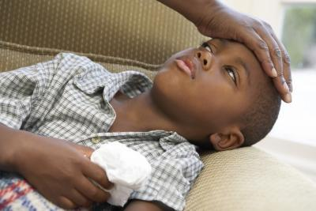
Is it harmful?
Signs and Symptoms
Signs occur after 4 months( infants)
Anemia ; Fatigue, shortness of breath, paleness.
Severe Pain ; Sudden pain in bones, lungs, joints, etc….
Notes:
A new born baby with Sickle cell anemia will not show any signs before 4 months of age. Signs and symptoms of sickle cell anemia vary from normal to extreme conditions. Some people have slight symptoms and others have severe symptoms and should be treated repetitively in hospitals. The most common symptom of anemia is fatigue, other signs include shortness of breath, paleness, dizziness, headache, chest pain, and other physical complications. (Resnik, Rehm, and Rich 29)

Slide 8

Complications of Sickle cell anemia
Acute chest syndrome
            Sickle cells trapped in lungs
          Priapism
              Unwanted erections
              Organ Failure
              Lungs, liver, kidneys
Notes:
Acute chest syndrome is a serious condition in which sickle cells are trapped in the lungs. This may lead to abnormal pain or even death. Another condition that only happens in males is Priapism. This is a condition were males might have unwanted erections, and this is due to clusters of sickle cells in the males penis. Organ failure is one of the most serious conditions but rare. Kidneys, lungs and Liver may disfunction due to lack of Oxygen. This ,ay also lead to death. (Robinson and Riley 23)

Slide 9

Physiological problems
Poor and Urban people
Affected
Social, emotional, academic and family issues arises.
Anxiety and depression
Notes:
Social, emotional, academic, and family adjustment of 327 children with Sickle Cell Anemia who were being treated at a comprehensive sickle cell clinic serving a primarily poor and urban population. 25 percent of these children had emotional adjustment problems in the form of adopting symptoms such as anxiety and depression. In addition, social functioning and academic performances were another problems.(Barbarin, Whitten, and Bonds)

Slide 10

Physiological problems
(continued)
Dysfunction may occur in four main domains:
Physiological functioning
Academic Functioning
Social Functioning
Family Functioning
Notes:
This disease id directly associated with the risk of adverse developments outcomes. These outcomes may occur in several domains : physiological functioning(low self esteem, fear, depression), academic functioning(failure, poor grades, poor thinking), social functioning( lack of friends, poor relationships), and family functioning(poor relationships with parents and peers). (Barbarin, Whitten, and Bonds)

Slide 11
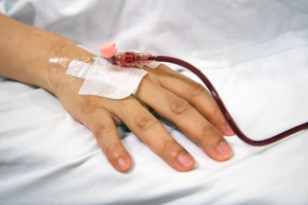
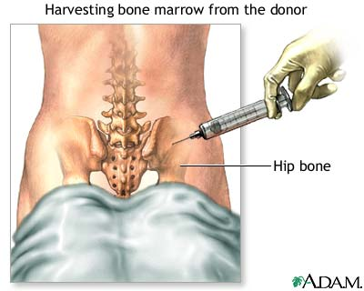
Treatments
Blood transfusions
Replacing sickled- cell blood
Bone marrow transplant
Taken from donors bone marrow
Notes:
People with sickle cell anemia who suffer strokes or infections, who are pregnant, or who must undergo surgery may be treated with blood transfusions. A patient will be replaced with normal blood that has been taken from a donor. Sickle cell anemia can be cured by a bone marrow transplant, which replaces the defective red blood cells with healthy cells from a donor. This process is much dynamic as it will create new blood cells in the patients bone marrow.(Darity, Roberson, and Reed 97)

Slide 12

Further Treatments
Penicillin Treatment
Life expectancy
Hydra Treatment
Treatment of leukemia and cancers
Notes:
Despite the absence of an operative treatment, life expectancy for individuals has improved. Early initiation of penicillin have come to relieve the symptoms of a painful episode. A recent study found that half of all patients were able to survive to their 40’s. Hydra treatment is approved by FDA to treat certain types of leukemia and other cancers. Doctors have been interested in Hydrea for the treatment of sickle cell anemia for about 10 years. Studies in humans showed that the drug could increase the level of fetal hemoglobin in red blood cells. (Mayfeild)

Slide 13

Conclusion
This disorder cannot be controlled as it is inherited from past generations. People with sickle cell suffer from various types physical discomfort. This directly affects their social, academic, physiological, and even family functioning. People with sickle cell will not have a extensive life expectancy due to their extreme conditions. However with the new treatments and medical advancements, a patient will be able to have finer life spans and comforts.

Slide 14
Work Cited
Barbarin, Oscar A., Charles F. Whitten, and Sandy M. Bonds. "Estimating Rates of Psychosocial Problems in Urban and Poor Children with Sickle Cell Anemia." Health and Social Work 19.2 (1994): 112+. Questia. Web. 19 Feb. 2013.
Burnes, David P. R., Beverley J. Antle, Charmaine C. Williams, and Lisa Cook. "Mothers Raising Children with Sickle Cell Disease at the Intersection of Race, Gender, and Illness Stigma." Health and Social Work 33.3 (2008): 211+. Questia. Web. 19 Feb. 2013.
Darity, William, Sr., Noma L. Roberson, and Wornie L. Reed. Health and Medical Care of African-Americans. Westport, CT: Auburn House, 1993. Questia. Web. 19 Feb. 2013.
Drotar, Dennis, ed. Promoting Adherence to Medical Treatment in Chronic Childhood Illness: Concepts, Methods, and Interventions. Mahwah, NJ: Lawrence Erlbaum Associates, 2000. Questia. Web. 19 Feb. 2013.
Frank-Kamenetskii, Maxim D. Unraveling DNA: The Most Important Molecule of Life. Trans. Lev Liapin. Revised ed. Reading, MA: Perseus, 1997. Questia. Web. 19 Feb. 2013.
Fullwiley, Duana. The Enculturated Gene: Sickle Cell Health Politics and Biological Difference in West Africa. Princeton, NJ: Princeton UP, 2012. Questia. Web. 19 Feb. 2013.

Slide 15
Work cited( Continued)
Kessler, James H., J. S. Kidd, Renée A. Kidd, and Katherine A. Morin. Distinguished African American Scientists of the 20th Century. Phoenix: Oryx, 1996. Questia. Web. 19 Feb. 2013.
Mayfield, Eleanor. "New Hope for People with Sickle Cell Anemia." FDA Consumer May 1996: 16+. Questia. Web. 19 Feb. 2013.
Pines, Maya. Inside the Cell: The New Frontier of Medical Science. Bethesda, MD: US Dept. of Health Education, and Welfare, Pubic Health Service, 1978. Questia. Web. 19 Feb. 2013.
Rensberger, Boyce. Life Itself: Exploring the Realm of the Living Cell. New York: Oxford UP, 1996. Questia. Web. 19 Feb. 2013.
Resnik, David, Marsha Rehm, and Ben A. Rich. "Pain and Sickle Cell Anemia." The Hastings Center Report 31.3 (2001): 29. Questia. Web. 19 Feb. 2013.
"Sickle Cell Disease." The Columbia Encyclopedia. 6th ed. 2012. Questia. Web. 19 Feb. 2013.

Slide 16
Work Cited(continued)
Anionwu, Elizabeth N., and Karl Atkin. The Politics of Sickle Cell and Thalassaemia. Philadelphia: Open UP, 2001. Questia. Web. 9 Mar. 2013.
Block, Andrew R., Edwin F. Kremer, and Ephrem Fernandez, eds. Handbook of Pain Syndromes: Biopsychosocial Perspectives. Mahwah, NJ: Lawrence Erlbaum Associates, 1999. Questia. Web. 9 Mar. 2013

